Slide 1

A STUDY ON CONSUMER BEHAVIOUR DURING PURCHASES
Ms. SHIVANI BATTU (121317044008)
Ms. KODIPAKA CHATHURYA GOUD (121317044035)
Ms. SAHITHI RAYI (121317044050)

Slide 2
CONTENTS
ABSTRACT
OBJECTIVES
METHODOLOGY
FREQUENCY TABLES
CHI SQUARE
PROJECT REPORT
BIBILOGRAPHY
INTRODUCTION

Slide 3

ABSTRACT

Slide 4

Present study is aimed to investigate consumers and their buying behavior in general. Consumer behavior involves the psychological processes that consumers go through in recognizing needs, finding ways to solve these needs, making purchase decisions, interpret information, make plans, and implement these plans.
The objective of the research endeavor is to achieve a better understanding of consumer behavior with the manifold factors that influence consumer buying processes. It aims to identify different streams of thought that could guide future consumer research.
A sample size of 160 was chosen to get respondents. Descriptive type of research design is used in the study and Convenience sampling technique is used in the research.
The age group started from 13 as to understand the fashion evolution.

Slide 5



Slide 6



WHAT IS CONSUMER BEHAVIOUR ?
Consumer behavior is the study of how individual customers, groups or organizations select, buy, use, and dispose ideas, goods and services to satisfy their needs and wants.
It refers to the actions of the consumers in the marketplace and the underlying motives for those actions.
Consumer’s interest to purchase a product or a service always depends on the willingness to buy and at the same time the ability to pay for that product.
Though they are willing to buy and are able to pay, their buying decisions change because of the influence of various factors such as psychological factors, personal factors, cultural factors, social factors, the influence of family members, economic factors, social media, etc.
Consumer buying behavior always reflects why consumers buy products with interest? What are the factors that influence them? How do they take purchase decisions ?

Slide 7
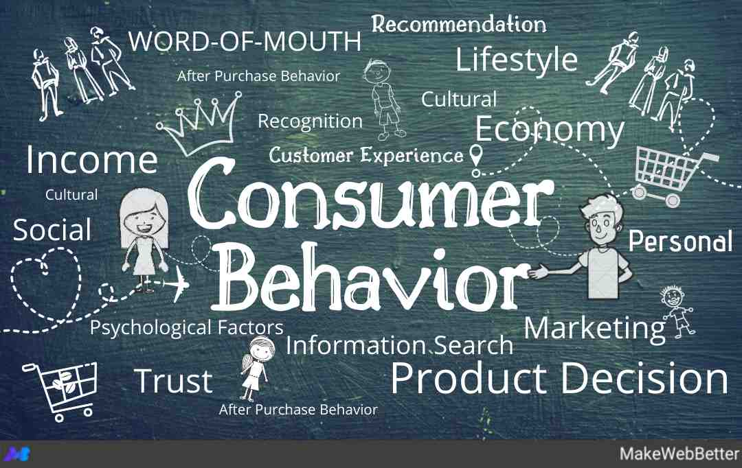
HISTORY :
Consumer behavior emerged during 1940 - 1950s as a distinct sub-discipline in the marketing area.
In its early years, consumer behavior was heavily influenced by motivation research, which had increased the understanding of customers, and had been used extensively by consultants in the advertising industry and also within the discipline of psychology in the 1920s, '30s and '40s.
By the 1950s, marketing began to adopt techniques used by motivation researchers including depth interviews, projective techniques, thematic perception tests and a range of qualitative and quantitative research methods.

Slide 8

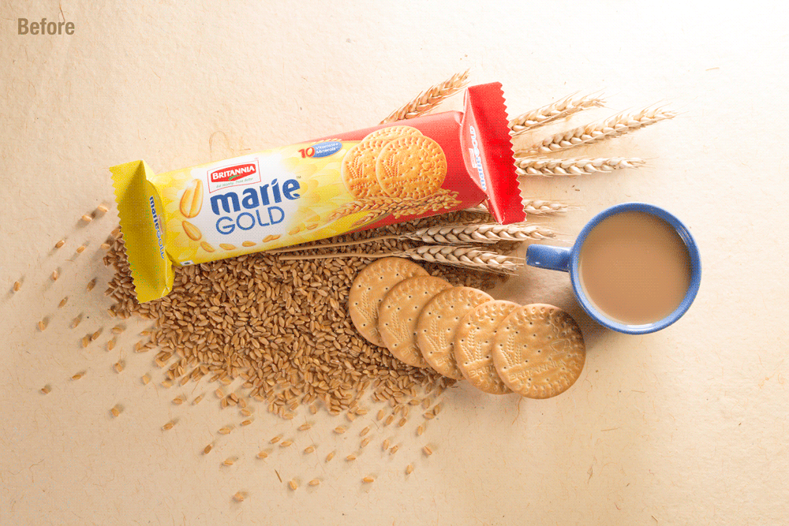
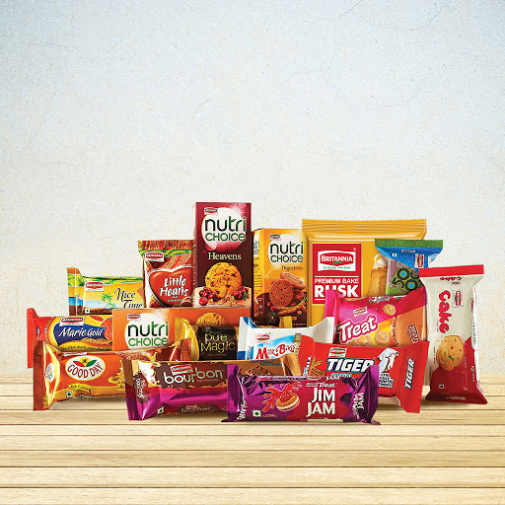
EVOLUTION

Slide 9
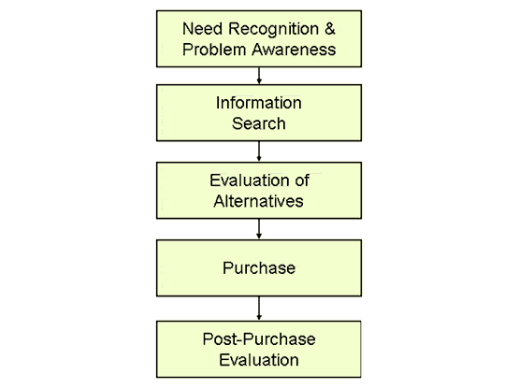
BUYER'S DECISION-MAKING PROCESS :
Though there are many factors influencing buyer’s decisions, the final result of purchase may be the result of a single factor or due to several factors.
Consumer’s decision-making process involves recognizing the need, search for information, evaluation of alternative, purchase decision, and post-purchase behavior.
So the decisions can be made before the purchase, during the purchase of a product /service and after purchase.

Slide 10
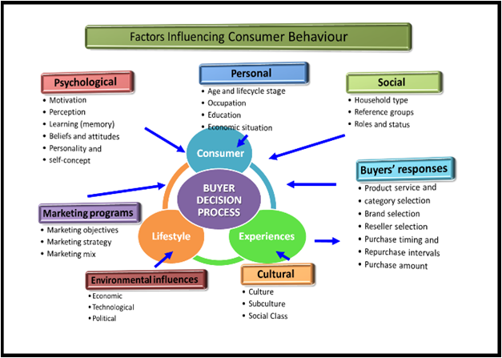

Slide 11


FACTORS
PSYCHOLOGICAL FACTORS :
> Purchase decisions always depend on the perception levels of the consumers.
> The perception levels vary from one individual to another which may depend on need, influence, motivation, and finally how they perceive things to take decisions.

Slide 12
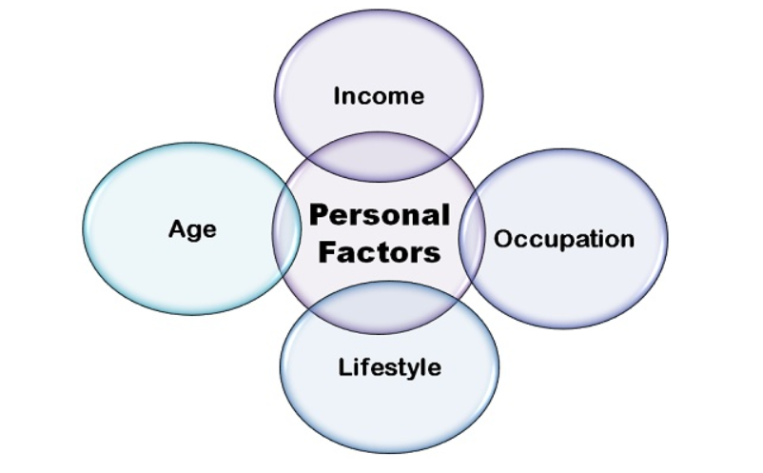
PERSONAL FACTORS : >Another important factor is personal factor It involves occupation, age, gender, lifestyle, income levels, personality traits, etc., which show major influence on the buyer’s behavior. >Personality traits such as characteristics, interests, beliefs, and attitudes influence a person to take the decision of purchase or not.

Slide 13
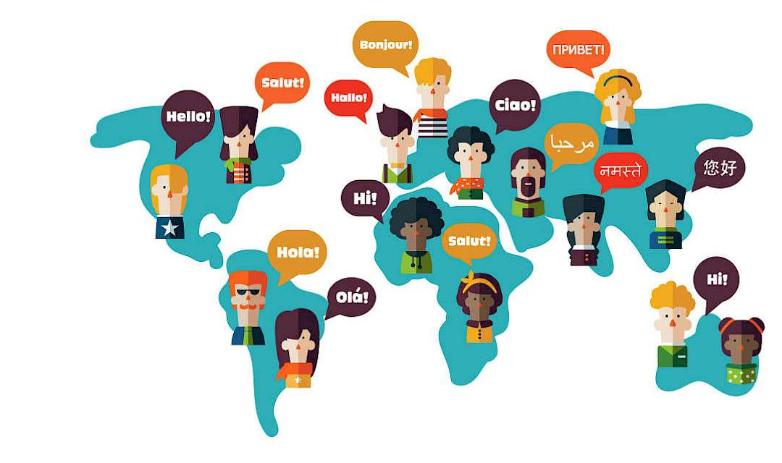
CULTURAL FACTORS :
> Culture refers to the set of values, beliefs, and ideologies of the society or group, where an individual learns from their family, society and hence follows the same .
> The way of dressing, wearing ornaments, eating habits, etc of a community is the result of cultural factors.
Eg : We all know McDonald's is a successful global brand, so unlike its menu, McDonald's practices "glocal" marketing efforts. That is not a type error. McDonald's brings a local flavor, literally, to different countries with region-specific menu items. In 2003, McDonald's introduced the McArabia, a flatbread sandwich, to its restaurants in the Middle East. This "glocal" approach has helped put McDonald's at #9 on Interbrand's Best Global Brands 2014.

Slide 14

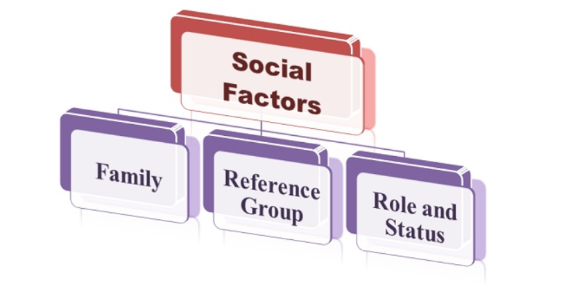
SOCIAL FACTORS : > Various social factors show influence on the consumer behavior. Every individual follows the culture and trend of their society and hence they may be influenced by the various factors such as status, role in the society and reference groups. > Depending on the societal status, individual need and influence of social groups, consumer behavior is determined and this is beneficial for businesses.

Slide 15
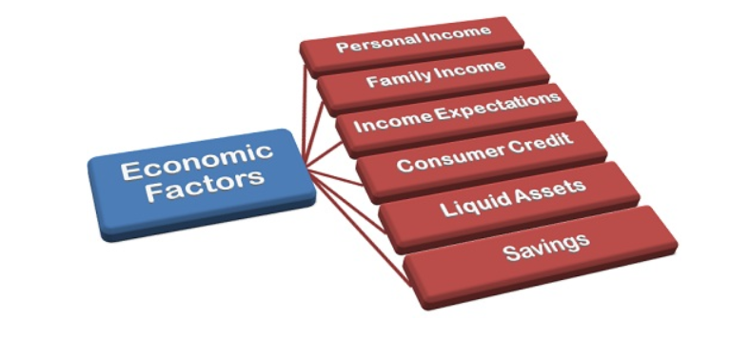
ECONOMIC FACTORS :
> Economic status of an individual and a country rules the purchase decisions of the customers.
> If per capita income of individuals is less than a country’s economic condition then the high-end products and services may not become successful in such economic conditions.

Slide 16

SALES AND MARKETING
MARKETING:
> The key to a successful marketing campaign lies in consumer behavior.
> The only way to influence consumers purchasing decision is to understand their buying behavior.
> A marketing plan includes pricing, promotion, place, and product (the 4 P's).
> Understanding the customer is a key component in building an effective marketing strategy.
SALES:
> Sales are activities related to selling or the number of goods or services sold in a given time period.
> A person or organization expressing an interest in acquiring the offered item of value is referred to as a potential buyer, prospective customer, or prospect.
> Sales can include offers, discounts , coupons, lucky draws which are major factors for attracting the consumers to buy products.

Slide 17
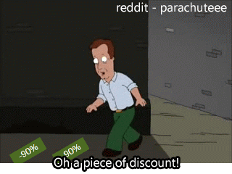

DISCOUNTS:
> Most discounts work on the principle of urgency, as the discounts are only available for a specific period of time.
> If people don’t buy the product now, at the discounted price, they’re likely to miss out on saving some money. That anticipation of missing out is exactly why discounts work.
WARRANTY :
> Product warranty is an important part of the marketing and sales program of new products.
> A warranty is a promise to provide repair, maintenance, replacement or refund of a product for a certain time period.

Slide 18
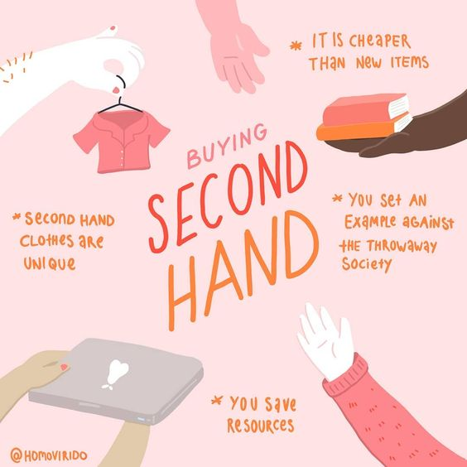

SECOND HAND BUYING :
> A secondhand or used good is a piece of personal property that is being purchased by or otherwise transferred to a second or later end user.
> Some things are typically sold in specialized shops, such as a car dealership that specializes in the sale of used vehicles or a used bookstore that sells used books.
HAND-ME-DOWN SALES :
> Goods transferred between friends and family for free are considered to be hand-me-down goods.
> Here there is no profit or loss but in turn the consumer will have to use a second hand product.
> Some of the examples include – Mobile, Clothes, Furniture ,Toys, etc

Slide 19

OBJECTIVES

Slide 20
OBJECTIVES
To understand consumers behavior and different types of consumers.
To examine the attitude of consumers towards purchases.
To understand the relationship between consumer behavior and the marketing concepts.
To understand how new technologies are enabling to satisfy the needs and wants of the consumer.
To study the relationship between consumer behavior over satisfaction and trust.

Slide 21




METHODOLOGY

Slide 22



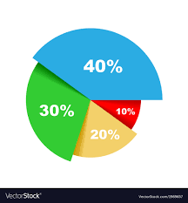
SAMPLE DESIGN:
Random samples of 160 respondents was chosen for the research through the questionnaires developed to find out the activities in which present day people are more interested and are involved.
SOURCE OF DATA :
Primary Data: The data, which has been collected for the first time and is original, is primary data. In this project the primary data is in the form of structured questionnaire.
Secondary Data: The secondary information is mostly taken from websites, books, journals, and magazines.
DIAGRAMATIC REPRESENTATAION:
Bar Diagram: A bar graph is a chart that uses bars to show comparisons between categories of data. The bars can be either horizontal or vertical. Bar graphs with vertical bars are sometimes called vertical bar graphs.
Pie chart: A pie chart is a circular chart divided into sectors; each sector shows the relative size of each value.

Slide 23
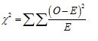
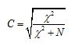
MODE OF DATA COLLECTION: Questionnaire method.
POPULATION: Population considered for study is the population using the products of all categories (both online and offline).
SAMPLE: Sample of 160 people was taken from various MNC’S, service sectors, students in Hyderabad.
DATA TABULATION AND STATISTICAL ANALYSIS : The questionnaire was serially numbered, and data was coded ,tabulated and analyzed using SPSS Statistics 26th version.
CHI-SQUARE TEST FOR INDEPENDENCE OF ATTRIBUTES: The chi-square test is used to test the independence of attributes. With the help of this test it is possible to assess the significance of difference between the observed and expected frequencies.
DECISION RULE: If p value<0.05, then p is significant, and we reject H₀ i.e., the attributes are independent at 5%level of significance.
COEFFICIENT OF CONTINGENCY: When H₀ is rejected the amount of association between two attributes is given by Coefficient of contingency.
where N=total frequency, χ²=calculated

Slide 24
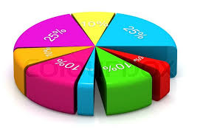

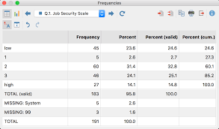
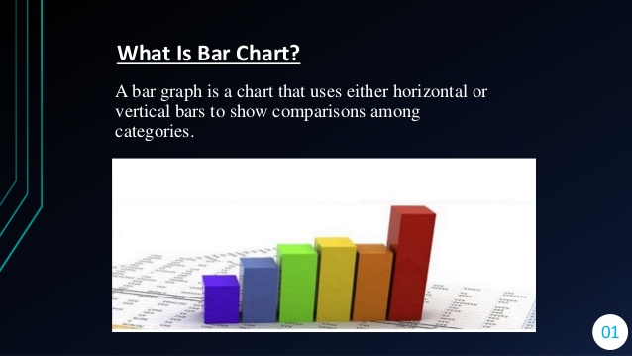
FREQUENCY TABLES, PIE CHARTS , AND BAR GRAPHS

Slide 25
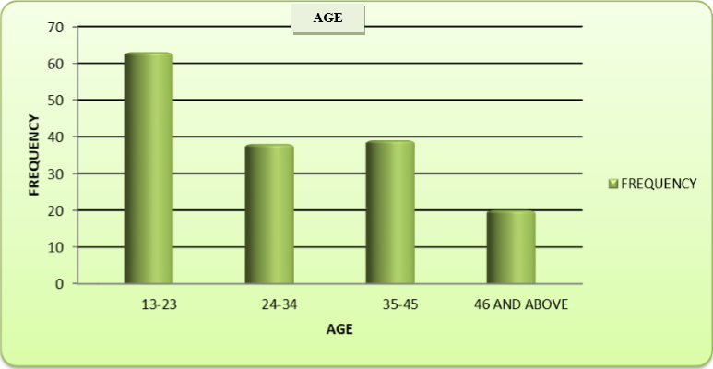
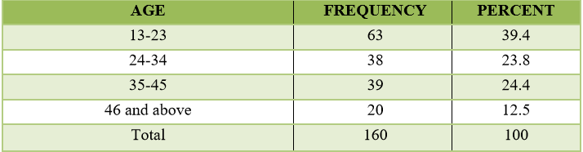
1.AGE 1) 13-23 2) 24-34 3) 35-45 4) 46 and above
CONCLUSION:
From the above Table and Diagram, it is observed that
39.4% (63) of respondents are mostly of the Age group 13-23
23.8% (38) of respondents are mostly of the Age group 24-34
24.4% (39) of respondents are mostly of the Age group 35-45
12.5% (20) of respondents are mostly of the Age group 46 and Above.

Slide 26
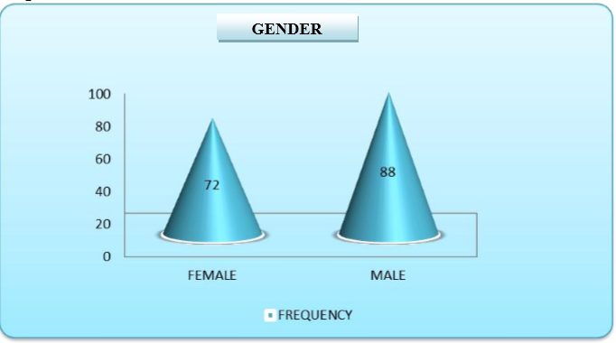
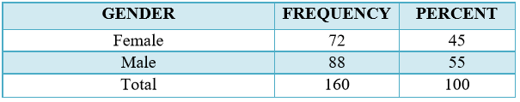
2.GENDER 1) Female 2) Male 3) Others
CONCLUSION:
From the above Table and Diagram, it is observed that
45% (72) of the respondents are females.
55% (88) of the respondents are male.

Slide 27
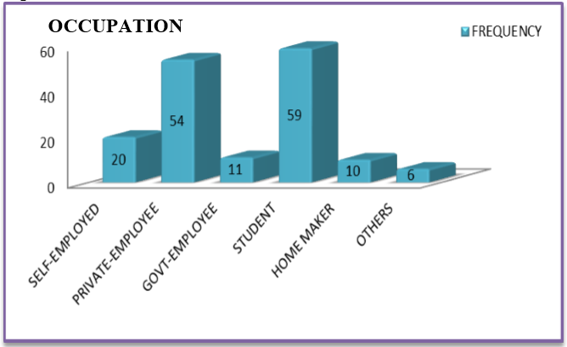
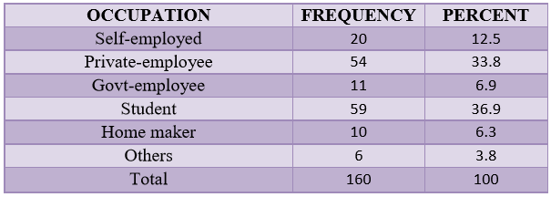
3 .OCCUPATION 1) Self –employed 2) Private employee 3) Government employee 4) Student 5) Home maker 6) Others
CONCLUSION:
From the above Table and Diagram, it is observed that
12.5% (20) of the respondents are self-employed.
33.8% (54) of the respondents are private employee.
6.9% (11) of the respondents are government employees.
36.9% (59) of the respondents are students.
6.3% (10) of the respondents are home makers.
3.8% (6) of the respondents are doing other jobs that are not mentioned

Slide 28
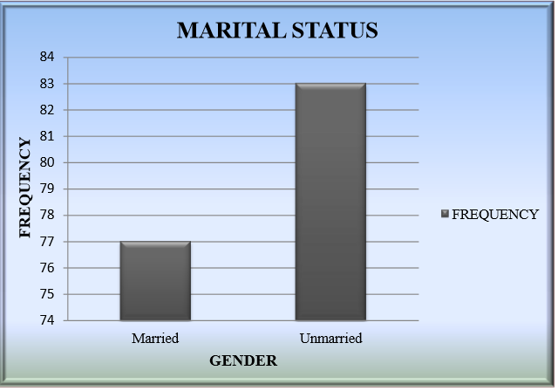
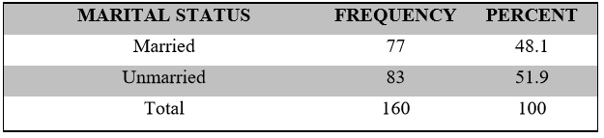
4. Marital status 1) Married 2) Unmarried
CONCLUSION:
From the above Table and Diagram, it is observed that
48.1% (77) of the respondents are married.
51.9% (83) of the respondents are unmarried.

Slide 29
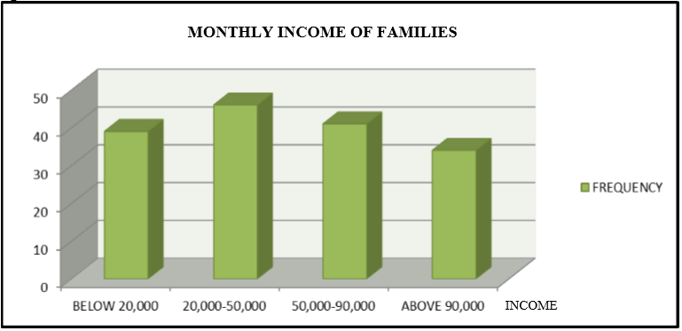
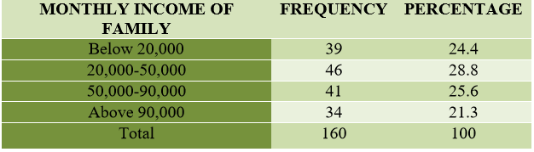
5. Monthly income of your family 1) Below 20000 2) 20000-50000 3) 50000-90000 4) Above 90000
CONCLUSION:
From the above Table and Diagram, it is observed that
24.4% (39) of the respondents have their monthly income below 20000.
28.8% (46) of the respondents have their monthly income between 20000-50000.
25.6% (41) of the respondents have their monthly income between 50000-90000.
21.3% (34) of the respondents have their monthly income above 90000.

Slide 30
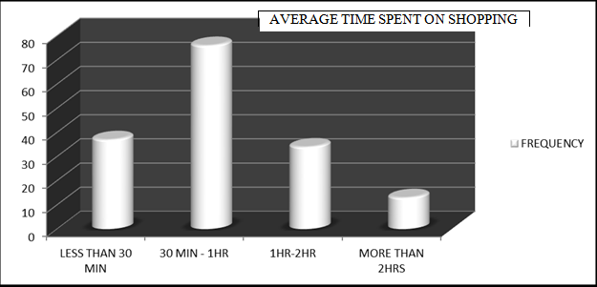
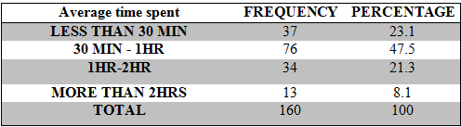
6. What is the average time you spend on purchasing a product 1) Less than 30 min 2) 30min-1hr 3) 1hr - 2hrs 4) More than 2hrs
CONCLUSION:
From the above Table and Diagram, it is observed that
47.5%(76)of the respondents spend 30 min-1hr for purchasing a product.
23.1%(37) of the respondents spend less than 30 minutes for purchasing a product.
21.3%(34) of the respondents spend 1hr-2hr for purchasing a product.
8.1%(13) of the respondents spend more than 2hrs for purchasing a product.

Slide 31
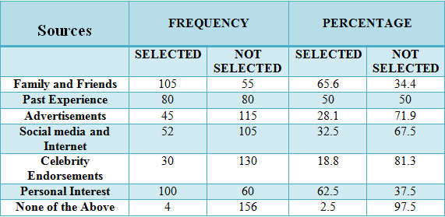
7. What are the sources of information that influence your buying decisions to catch-up with life trends ( more than one option can be selected ) 1) Family and friends 2) Past experience 3) Advertisements 4)Social media and internet 5) Celebrity endorsements 6) Personal interest 7) None of the above

Slide 32
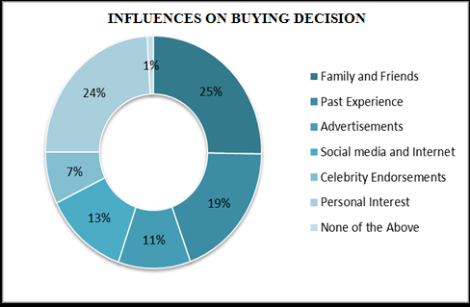
CONCLUSION:
65.6%(105) of the respondents selected family and friends as the source of information that influences buying decision .
50%(80) of the respondents selected past experience as the source of information that influences buying decision .
28.1%(45)of the respondents selected advertisements as the source of information that influences buying decision .
32.5%(52) of the respondents selected social media and internet as the source of information that influences buying decision .
18.8%(30) of the respondents selected celebrity endorsement as the source of information that influences buying decision.
62.5%(100)of the respondents selected personal interest as the source of information that influences buying decision .
2.5%(4)of the respondents selected none of the above as the source of information that influences buying decision .

Slide 33
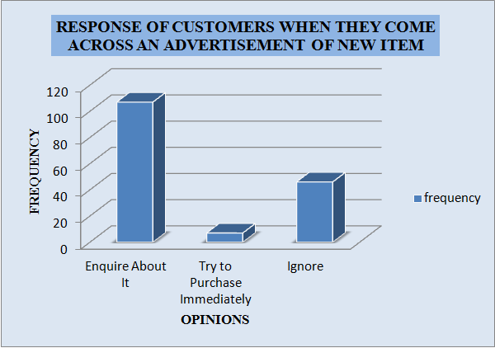
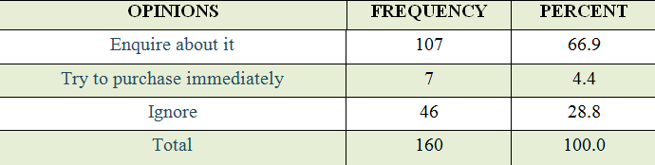
8. What would you do if you come across an advertisement of new item? 1) Enquire about it 2) Try to purchase immediately 3) Ignore
CONCLUSION:
From the above table and diagram, it is observed
66.9% (107) of the respondents like to enquire about the product.
4.4% (7) of the respondents like to try to purchase immediately.
28.8% (46) of the respondents like to ignore.

Slide 34
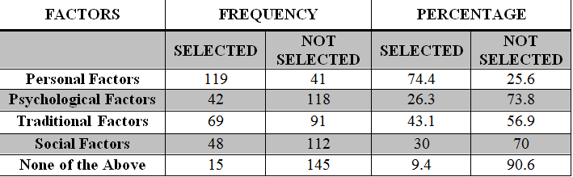
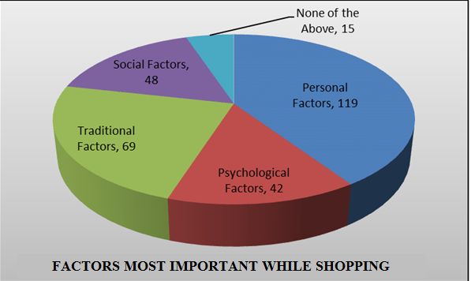
9.What are the factors that are most important to you while shopping? (more than one option can be selected) 1) Personal factors 2) Psychological factors 3) Traditional factors 4) Social factors 5)None of the above
CONCLUSION:
74.4%(119) of the respondents selected personal factors as most important while shopping.
26.3%(42) of the respondents selected psychological factors as most important while shopping.
43.1%(69) of the respondents selected traditional factors as most important while shopping.
30%(48) of the respondents selected social factors as most important while shopping.
9.4%(15) of the respondents selected none of the above.

Slide 35
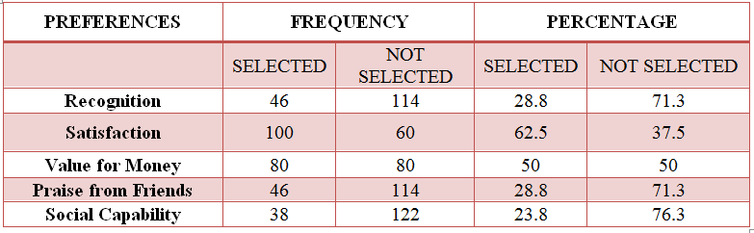
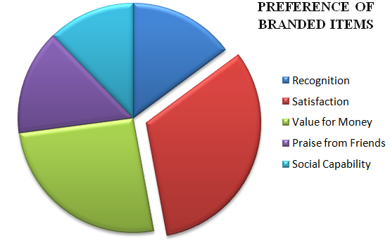
10. Why do you prefer branded items ? 1) Recognition 2) Satisfaction 3) Value for money 4) Praise from friends 5) Social capability
CONCLUSION:
28.8%(46) of the responses prefer branded items for recognition.
62.5%(100) of the responses prefer branded items for satisfaction.
50%(80) of the responses prefer branded items as it gives value for money.
28.8%(46) of the responses prefer branded items to get appreciated from friends.
23.8%(38) of the responses prefer branded items for social capability.

Slide 36
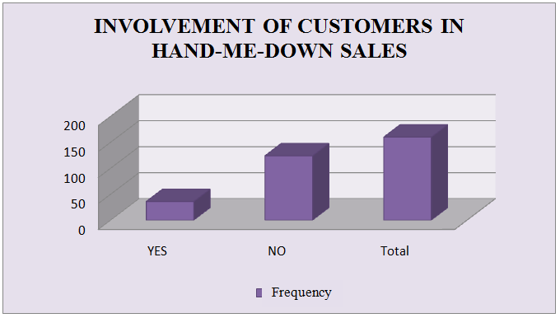
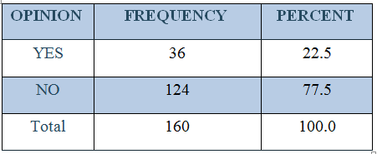
11. Have you ever been a part of Hand -me -down* sales ? (*Hand-me-down – Goods transferred informally between friends and family for free) 1) Yes 2) No
CONCLUSION:
From the above table and diagram it is observed that:
22.5%(36) of the respondents were a part of hand-me-down sales.
77.5%(124)of the respondents were not a part of hand-me-down sales.

Slide 37
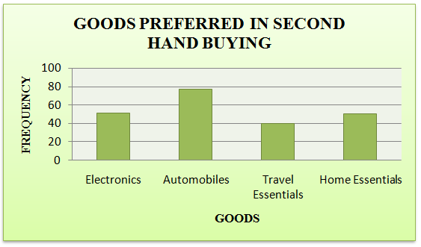
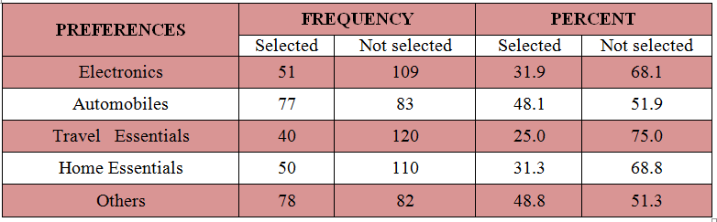
12.Which of the following goods do you usually prefer in second hand buying (more than one option can be selected): 1) Electronics 2) Automobiles 3) Travel Essentials 4) Home Essentials 5) Others
CONCLUSION: From the above table, it is observed that
31.9%(51) of the respondents selected electronics as their preferable option in second hand buying.
48.1%(77) of the respondents selected automobiles as their preferable option in second hand buying.
25%(40) of the respondents selected travel essential as their preferable option in second hand buying.
31.3%(50) of the respondents selected home essential as their preferable option in second hand buying.
48.8%(78) of the respondents selected other items as their preferable option in second hand buying.

Slide 38
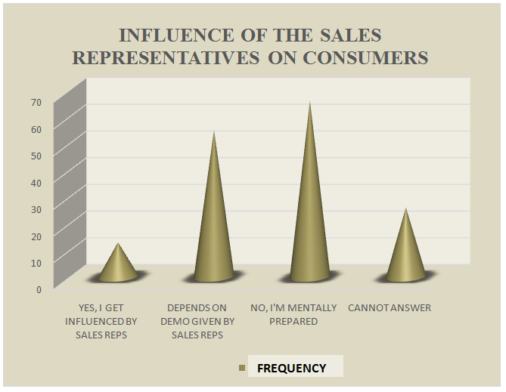
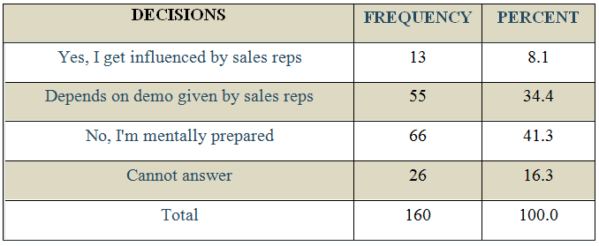
13. Do you always purchase the product that you decide on or do you get influenced by the sales representatives? 1) Yes, I get influenced by the sales representatives 2) Depends on the demo given by the sales representative 3) No, I’m mentally prepared 4) Cannot answer
CONCLUSION:
From the above table and diagram, it is observed that,
8.1%(13) of the respondents get influenced by the sales representatives.
34.4%(55) of the respondents depend on the demo given by the sales representatives.
41.3%(66) of the representatives are mentally prepared.
16.3%(26) of the respondents cannot answer to the question.

Slide 39
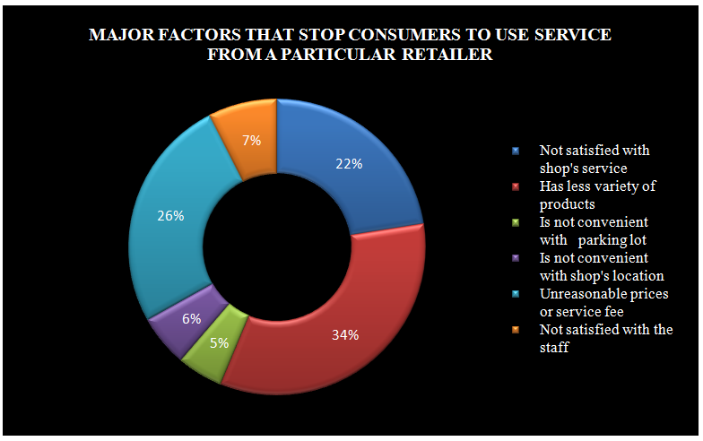
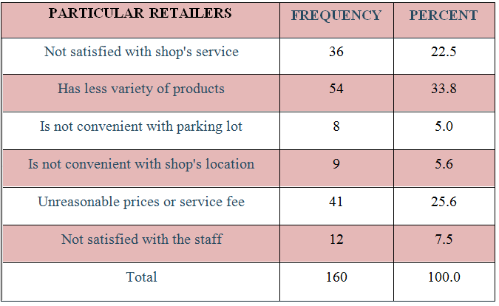
14.What are the major factors that make you stop using services from a particular retailer (Only one option to be selected) 1) Not satisfied with the shop’s service 2) Has less variety of products 3) Is not convenient with parking lot 4) Is not convenient with shop location 5) Unreasonable prices or service fees 6) Not satisfied with the staff
CONCLUSION:
From the above table and diagram , it is observed that
34% (54) of the respondents stop using services from a particular brand as it has less variety of products.
26% (41) of the respondents stop using services from a particular brand as it has unreasonable prices and service fee .
22% (36) of the respondents stop using services from a particular brand as they are not satisfied with shops service.
7% (12) of the respondents stop using services from a particular brand as they are not satisfied with the staff.
6% (9) of the respondents stop using services from a particular brand as they are not convenient with the shops location.
5% (8) of the respondents stop using services from a particular brand as they are not convenient with the parking lot.

Slide 40
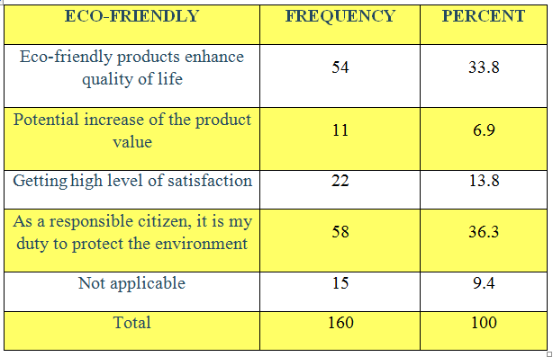
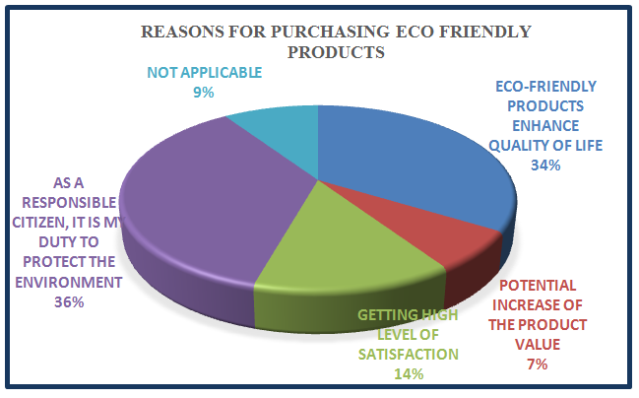
15. Why do you buy eco friendly products? 1) Eco-Friendly products enhance quality of life 2) Potential increase of the product value 3) Getting high level of satisfaction 4) As a responsible citizen, it is my duty to protect environment 5) Not applicable
CONCLUSION :
From the above table and diagram ,it is observed that
33.8%(54) of the respondents buy eco friendly products to enhance the quality of life.
6.9%(11) of the respondents buy eco friendly products as it leads to potential increase of product value.
13.8%(22)of the respondents eco friendly products as it gives high level of satisfaction.
36.3%(58) of the respondents feel that as a responsible citizen ,it’s their duty to protect the environment.
9.4%(15)of the respondents do not buy eco-friendly product.

Slide 41
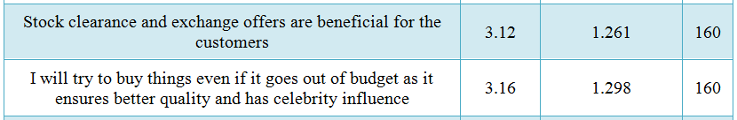
16. Please mark your level of agreement with the following statements 1-Stongly Agree 2- Agree 3- Neutral 4- Disagree 5-Strongly Disagree
S. No | Question | 1 | 2 | 3 | 4 | 5
1. | Stock clearance and Exchange offers are beneficial for the customers
2. | I will try to buy things even if it goes out of budget as it ensures better quality and has celebrity influence
CONCLUSION:
Most of the respondents Strongly agreed that
They will try to buy things even if it goes out of budget as it ensures better quality and has celebrity influence(mean=3.16)
Stock clearance and exchange offers are beneficial for the customers(mean=3.12)

Slide 42
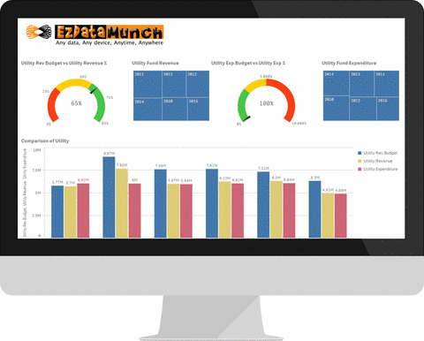

STATISTICAL ANALYSIS , TABULATIONS AND CHI - SQUARE TESTS (with and without pooling)

Slide 43
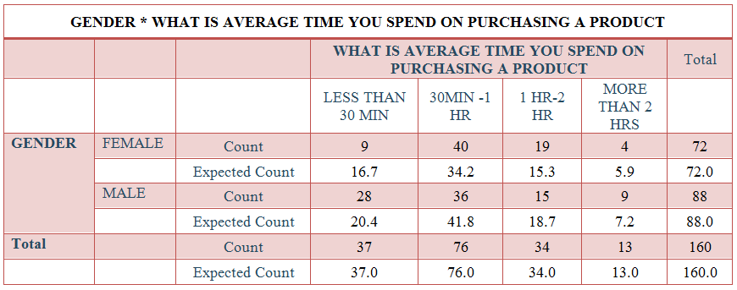
1. GENDER * WHAT IS THE AVERAGE TIME YOU SPEND ON PURCHASING A PRODUCT : Null Hypothesis (H₀) : There is no association between gender of people and the average time they spend on shopping. Alternative Hypothesis (H₁) : There is association between gender of people and the average time they spend on shopping.

Slide 44


CONCLUSION :
From the above table, we observe that the value of p < 0.05 i.e.,( 0.012 < 0.05). Therefore, we reject the Null Hypothesis and conclude that there is association between gender of people and the average time they spend on shopping.
Hence there is 25.2% association.

Slide 45

2. CATEGORIES YOU SHOP MOST OFTEN * WHICH FACTORS INFLUENCE YOU THE MOST WHILE CHOOSING PRODUCTS_NEW ARRIVALS : Null Hypothesis (H₀) : There is no association between the categories that consumers shop most often and the influence of a factor like new arrivals while choosing products. Alternative Hypothesis (H₁) : There is association between the categories that consumers shop most often and the influence of a factor like new arrivals while choosing products.

Slide 46

CONCLUSION :
From the above table, we observe that the value of p >0.05 i.e.,( 0.886 > 0.05). Therefore, we accept the Null Hypothesis and conclude that there is no association between the categories that consumers shop most often and the influence of a factor like new arrivals while choosing products.

Slide 47

3. WHAT IS THE AVERAGE TIME YOU SPEND ON SHOPPING * WHICH MODE OF SHOPPING DO YOU USUALLY PREFER : Null Hypothesis (H₀) : There is no association between the average time spent on shopping and the mode of shopping preferred by consumers. Alternative Hypothesis (H₁) : There is association between the average time spent on shopping and the mode of shopping preferred by consumers. BEFORE POOLING:

Slide 48


Since 1 cell has expected count less than 5, we perform the method of pooling . Therefore, we pool 3rd & 4th rows. AFTER POOLING :

Slide 49

CONCLUSION : From the above table, we observe that the value of p >0.05 i.e.,( 0.226 > 0.05). Therefore, we accept the Null Hypothesis and conclude that there is no association between the average time spent on shopping and the mode of shopping preferred by consumers.

Slide 50

4. AGE * BRAND NAME INFLUENCES PURCHASE DECISIONS : Null Hypothesis (H₀) : There is no association between age of people and the influence of brand name on their purchase decisions . Alternative Hypothesis (H₁) : There is association between age of people and the influence of brand name on their purchase decisions . BEFORE POOLING :

Slide 51


Since 4 cells have expected count less than 5, we perform the method of pooling . Therefore, we pool 3rd & 4th rows.
AFTER POOLING :

Slide 52


CONCLUSION :
From the above table, we observe that the value of p < 0.05 i.e.,( 0.000 < 0.05). Therefore, we reject the Null Hypothesis and conclude that there is association between age of people and the influence of brand name on their purchase decisions .
Hence there is 40.7% association.

Slide 53
INFERENCE
39.4% (63) of respondents are mostly of Age group 13-23; 23.8% (38) of respondents are mostly of Age group 24-34 ; 24.4% (39) of respondents are mostly of Age group 35-45 ; 12.5%(20) of respondents are mostly of Age group 46 and Above
45% (72) of the respondents are females ; 55% (88) of the respondents are male.
12.5% (20) of the respondents are self-employed ;33.8% (54) of the respondents are private employee ; 6.9% (11) of the respondents are government employees; 36.9% (59) of the respondents are students ; 6.3%(10) of the respondents are home makers ; 3.8% (6) of the respondents are doing other jobs .
48.1% (77) of the respondents are married and 51.9% (83) of the respondents are unmarried.
24.4% (39)of the respondents have their monthly income as below 20000;28.8% (46)of the respondents have their monthly income as 20000-50000;25.6% (41)of the respondents have their monthly income as 50000-90000;21.3% (34) of the respondents have their monthly income as above 90000.
70% (112)of the respondents prefer clothing as their most purchased item;6.3% (10) of the respondents prefer cosmetics as their most purchased item;12.5% (20) of the respondents prefer gadgets as their most purchased ite;11.3%(18) of the respondents prefer other items as their most purchased item.
13.8% (22) of the respondents prefer off sale shopping;11.3% (18) of the respondents prefer on sale shopping;75% (120) of the respondents prefer both off-sale and on-sale shopping.
56.9% (91) of the respondents selected clothing as the most influencing factor while choosing products.

Slide 54
53.8% (86) of the respondents selected discounts as influencing factor while choosing products.
40% (64) of the respondents selected new arrivals as influencing factor while choosing products.
21.3% (34) of the respondents selected compulsive shopping as influencing factor while purchasing product;33.8% (54) of the respondents selected no particular reason while purchasing a product.
56.9% (91) of the respondents spent 1000-5000 rupees on shopping in past 2 months;24.4% (39) of the respondents spent 5001-10000 rupees on shopping in past 2 months;6.9% (11)of the respondents spent 10001-15000 rupees on shopping in past 2 months;11.9% (19) of the respondents spent 15001 and above on shopping in past 2 months.
23.1% (37) of the respondents spend less than 30 minutes for purchasing a product; 47.5% (76)of the respondents spend 30 min-1hr for purchasing a product; 21.3% (34) of the respondents spend 1hr-2hr for purchasing a product.;8.1% (13) of the respondents spend more than 2hrs for purchasing a product.
26.9% (43) of the respondents prefer online shopping;73.1% (117)of the respondents prefer traditional shopping.
65.6% (105) of the respondents selected family and friends as the source of information that influences buying decision ;50% (80) of the respondents selected past experience as the source of information that influences buying decision ;28.1% (45)of the respondents selected advertisements as the source of information that influences buying decision ;32.5% (52) of the respondents selected social media and internet as the source of information that influences buying decision ;18.8% (30) of the respondents selected celebrity endorsement as the source of information that influences buying decision ; 62.5% (100)of the respondents selected personal interest as the source of information that influences buying decision ; 2.5% (4)of the respondents selected none of the above as the source of information that influences buying decision .

Slide 55
The most preferred category was ranked in the following order:
1. Clothing and apparel ; 2. Food items ; 3. Cosmetics ; 4. Electronics; 5. Home and kitchen ; 6. Accessories ; 7. Travel essential
66.9% (107) of the respondents like to enquire about the product;4.4% (7) of the respondents like to try to purchase immediately;28.8% (46) of the respondents like to ignore.
74.4%(119) of the respondents selected personal factors as most important while shopping;26.3% (42) of the respondents selected psychological factors as most important while shopping;43.1% (69) of the respondents selected traditional factors as most important while shopping;30% (48) of the respondents selected social factors as most important while shopping;9.4% (15) of the respondents selected none of the above.
13.8% (22) of the respondents think that online deliveries are better than offline purchases;36.9% (59) of the respondents think that online deliveries are not better than offline purchases;49.4% (79)of the respondents think that online deliveries maybe better than offline purchases.
73.8% (118) of the respondents selected quality as a basis to trust a particular brand;43.8% (70) of the respondents selected offers and coupons as a basis to trust a particular brand.;30% (48) of the respondents selected memberships as a basis to trust a particular brand;21.9% (35) of the respondents selected celebrity endorsement as a basis to trust a particular brand;15.6% (25) of the respondents selected all the above.
22.5% (36) of the respondents were a part of hand-me-down sales;77.5% (124)of the respondents were not a part of hand-me-down sales.

Slide 56
31.9% (51) of the respondents selected electronics as the preferable option in second hand buying.;48.1% (77) of the respondents selected automobiles as the preferable option in second hand buying;25% (40) of the respondents selected travel essential as the preferable option in second hand buying;31.3% (50) of the respondents selected home essential as the preferable option in second hand buying;48.8% (78) of the respondents selected other as the preferable option in second hand buying.
8.1% (13) of the respondents get influenced by the sales representatives;34.4% (55) of the respondents depend on the demo given by the sales representatives;41.3% (66) of the representatives are mentally prepared;16.3% (26) of the respondents cannot answer to the question.
34% (54) of the respondents stop using services from a particular brand as it has less variety of products; 26% (41) of the respondents stop using services from a particular brand as it has unreasonable prices and service fee ;22% (36) of the respondents stop using services from a particular brand as they are not satisfied with shops service;7% (12) of the respondents stop using services from a particular brand as they are not satisfied with the staff; 6% (9) of the respondents stop using services from a particular brand as they are not convenient with the shops location; 5% (8) of the respondents stop using services from a particular brand as they are not convenient with the parking lot.
13.1% (21) of the respondents prefer price while shifting from one brand to another brand;68.8% (110) of the respondents prefer quality while shifting from one brand to another brand;1.9% (3) of the respondents prefer promotion while shifting from one brand to another brand;7.5% (12) of the respondents prefer environmental friendly option while shifting from one brand to another brand;8.8% (14) of the respondents prefer interest in the new product as a option while shifting from one brand to another brand.
84.9% (143) of the respondents buy eco-friendly products;10.6% (17) of the respondents do not buy eco-friendly products.

Slide 57
33.8% (54) of the respondents buy eco-friendly products to enhance the quality of life; 6.9% (11) of the respondents buy eco-friendly products as it leads to potential increase of product value;13.8% (22)of the respondents eco-friendly products as it gives high level of satisfaction;36.3% (58) of the respondents feel that as a responsible citizen, it’s their duty to protect the environment; 9.4% (15)of the respondents do not buy eco-friendly product.
79.4% (127) of the respondents always share their experience; 20.6% (33) of the respondents leave it to others to find out what’s best for them.
Most of the respondents Strongly agreed that
1. They will try to buy things even if it goes out of budget as it ensures better quality and has celebrity influence (mean=3.16)
2. Stock clearance and exchange offers are beneficial for the customers (mean=3.12)
3. Warranty of the goods influences your buying decision (mean=3.02)
Most of the respondents agreed that
1. Going to shopping malls adds to your status (mean=2.98)
2. Brand name influences purchase decisions (mean=2.96)
Most of the respondents disagree and Strongly disagree that
1. Celebrities influence purchase decision of a product (mean=2.87)
2. Products are expensive more worthy than low cost products (mean=2.76)

Slide 58
CHI-SQUARE RESULTS :
There is 21.7% association between gender of people and the categories they shop most often.
There is 25.2% association between gender of people and the average time they spend on shopping.
There is no association between gender of people and the mode of shopping they prefer.
There is no association between the categories that consumers shop most often and the influence of a factor like new arrivals while choosing products.
There is 23.1% association between the age of people and the categories they shop most often.
There is no association between the average time spent on shopping and the mode of shopping preferred by consumers.
There is no association between age of people and the average time they spend on shopping.
There is 40.7% association between age of people and the influence of brand name on their purchase decisions.
There is 33.7% association between monthly income of a family and the money they spent on shopping in the past two months .
There is no association between monthly income of a family and the intention that going to shopping malls adds to an individual’s status.

Slide 59

PROJECT REPORT

Slide 60
PROJECT REPORT
70% of the respondents prefer clothing as their most purchased item.
From the survey, we observe that respondents have chosen Traditional shopping over Online shopping with a whopping 73.1% biased support.
Most of the respondents have selected personal satisfaction as a reason for buying branded items over other factors such as recognition, value for money, praise from friends, social capability.
There is no significant involvement of consumers in hand-me-down sales as the study shows that 77.5% of them have never been part of such sales.
From the study, it is found that Automobiles and other goods are most preferred in Second hand buying .
Sales representatives have a positive influence on the customers buying decision as it is observed from the survey that 34.4% of the consumers get influenced by the demo given by sales representatives.
Better Quality in the product is something that customers look for while shifting from one brand to another and the study supports this judgment with 68.8% positive votes.
Consumers mainly focus on the diversity of products available and might stop using services from a retailer due to less variety of products.
84.9% of the respondents have unanimously agreed that they purchase eco-friendly products and majority of them think that being a responsible citizen it is their duty to protect the environment.
From the survey we can say that gender and the time spent on shopping are positively associated.

Slide 61
BIBILOGRAPHY
Shahir Bhatt & Amola Bhatt through their research paper on Consumer Behavior Towards Packaged Food in Rural Areas: The study examines the relationship between the factors brought out and demographic factors like age and monthly income.
“Consumer Attitude Towards Luxury Brands”: An Empirical Study by Preeti Tak and Ashish Pareek has established a thought on the relationship between consumer’s need for uniqueness dimensions, fashion consciousness and consumer’s attitude towards luxury brands.
Subadra S,Murugesan K M & Ganapathi R (2010) studied “Consumer perceptions & Behavior” and concluded that consumer behavior consists of all human behavior that goes in making purchase decisions.
https://www.salesmate.io/resources/sales-strategies-revealed-sales-experts/
https://www.popoptiq.com/types-of-consumers/
https://www.beyondthehedgecreative.com/4-different-types-consumers-market/
https://www.omniconvert.com/blog/consumer-behavior-in-marketing-patterns-types-segmentation.html
https://medium.com/analytics-for-humans/the-evolution-of-consumer-behavior-in-the-digital-age-917a93c15888

Slide 62


